Slide 1
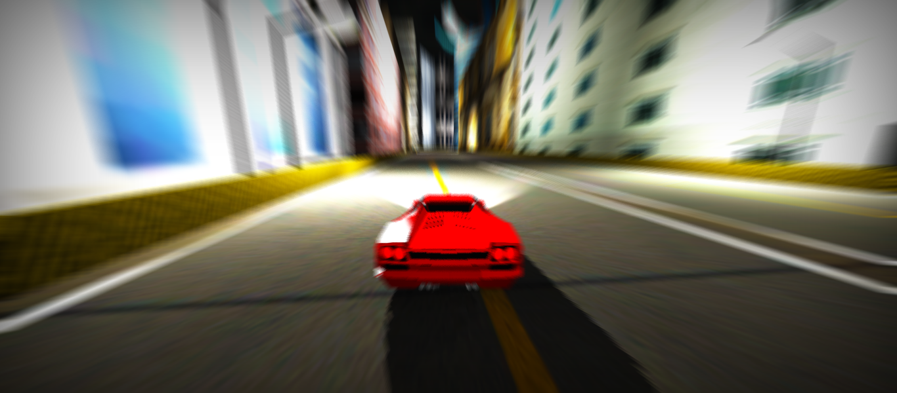

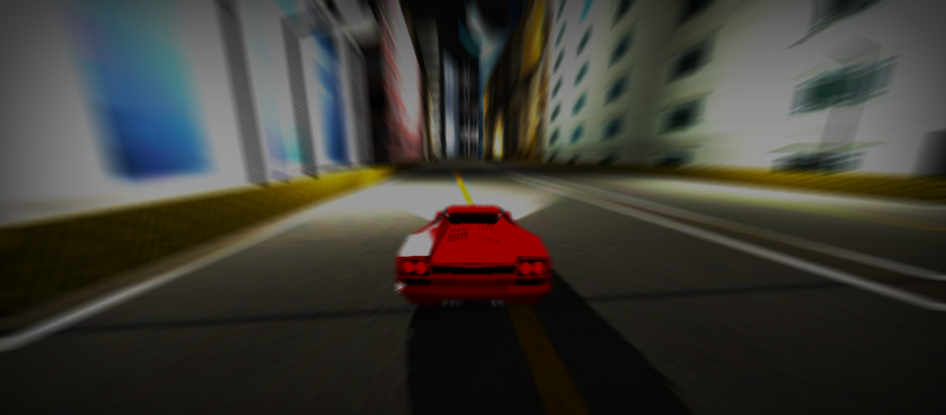
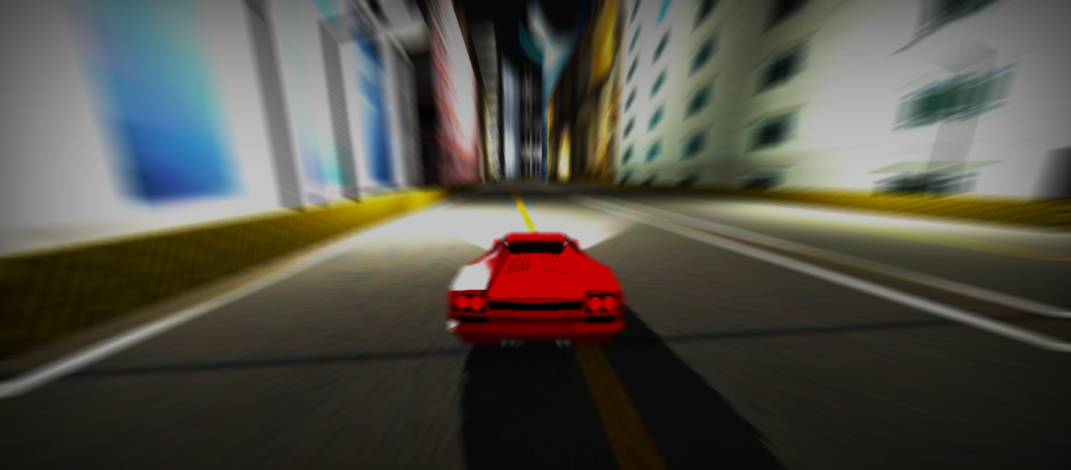
Shubhangi Gupta
Poorva Chodnekar
Amey Naiyan
Ganesh Namshikar
Sunil Hegde
3D Game Development
using Unity Engine
Visual Documentation

Slide 2


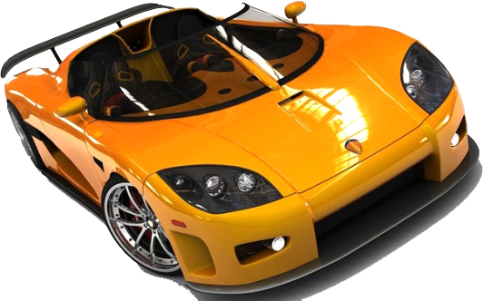
The Concept

Slide 3
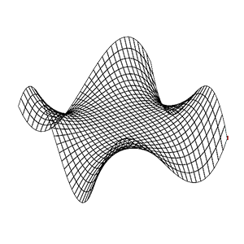


Racing Game
Development
Modeling
Tweaking
Rigging

Slide 4


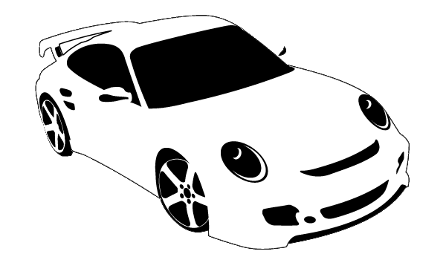
Modeling
Car
Environment

Slide 5




The Car
3D
Authoring
Tool
Blueprints
Manipulation
of Primitive
Objects
Texturing
Exporting

Slide 6
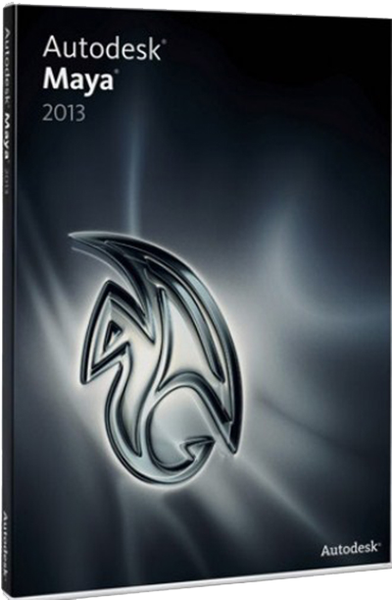
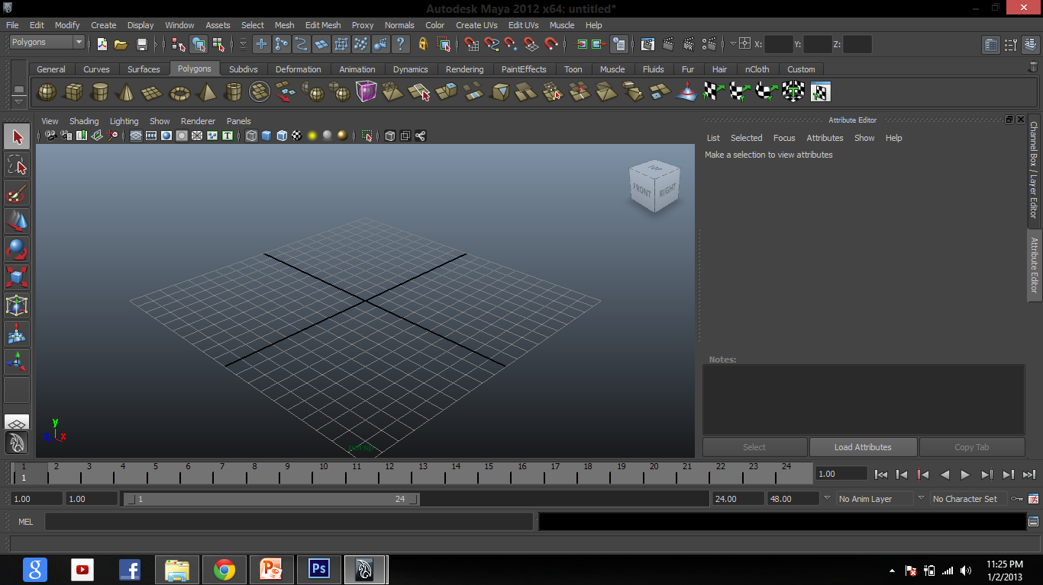
Autodesk Maya

Slide 7
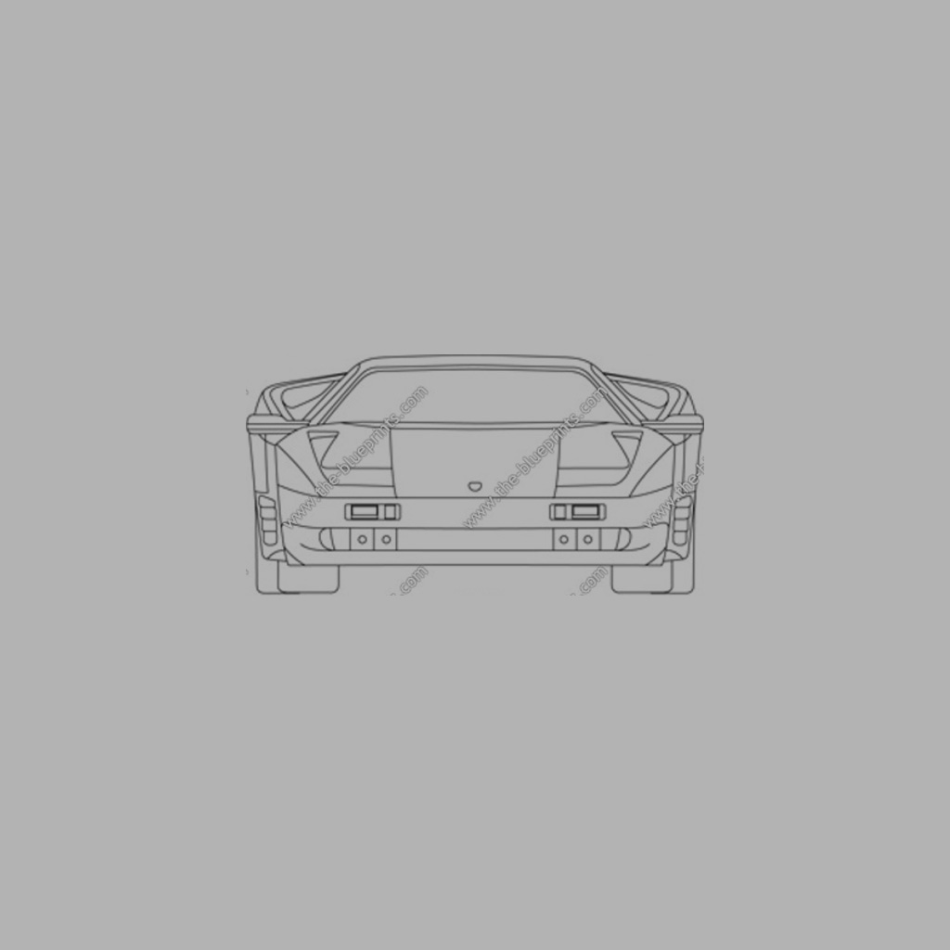
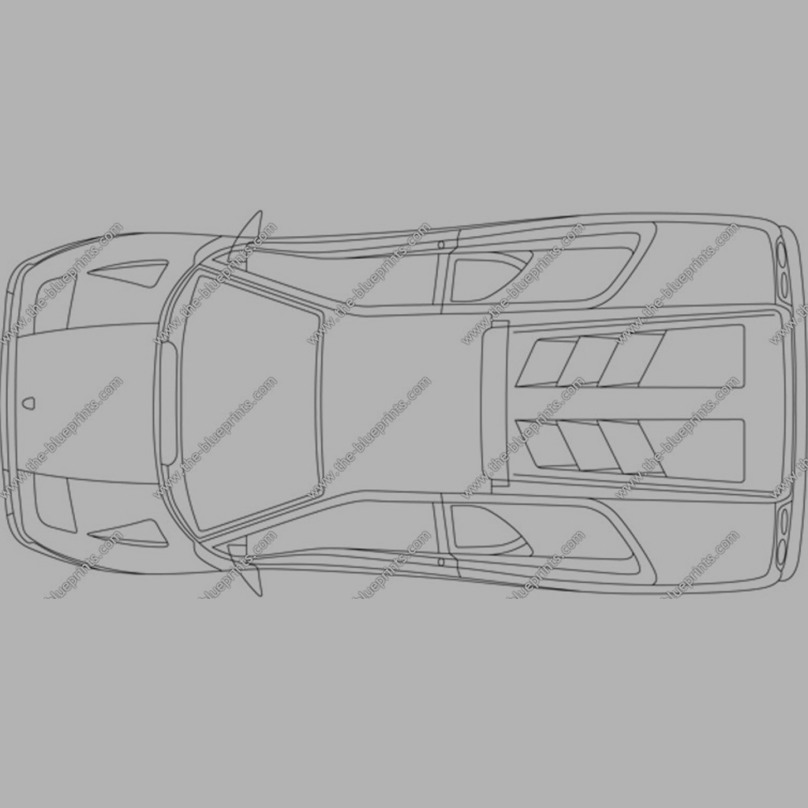
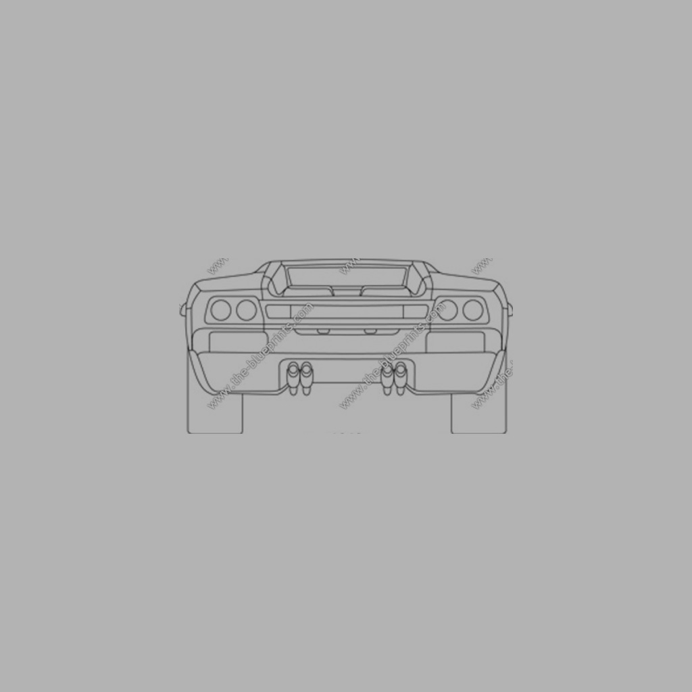
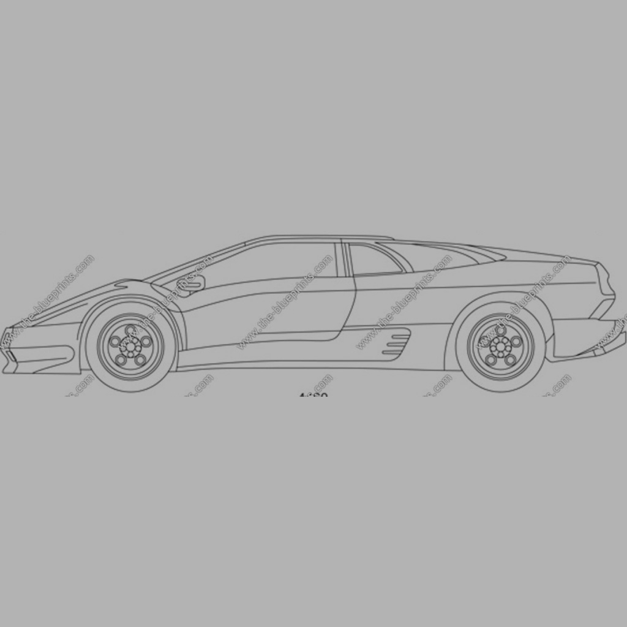
Front
Top
Image
Planes
Back
Side

Slide 8
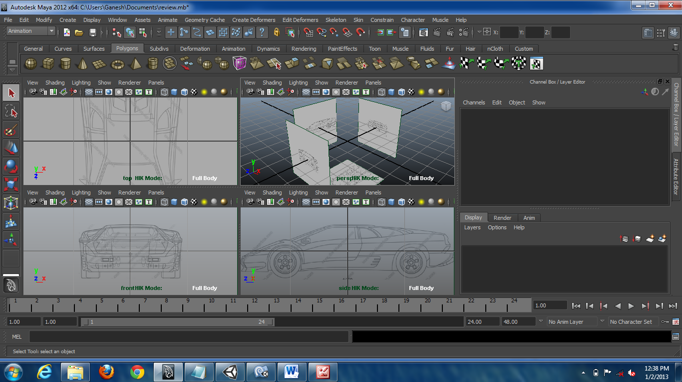
Views

Slide 9
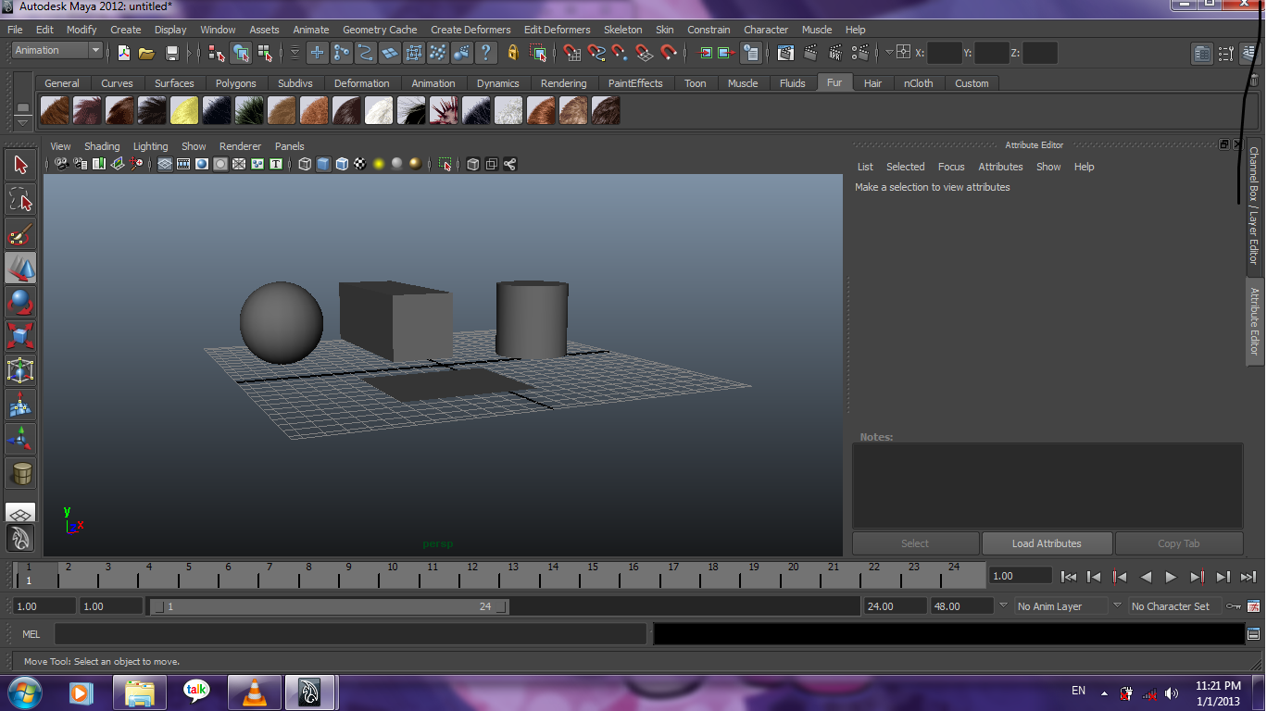
Primitive Objects

Slide 10
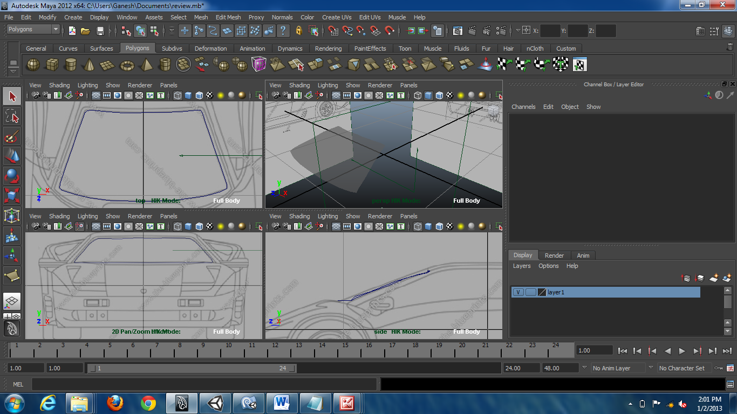

Slide 11
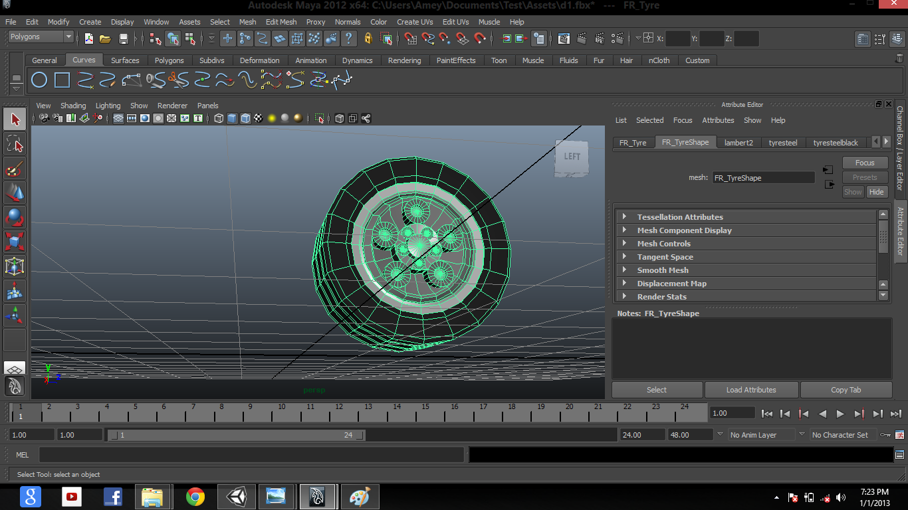
Extrusion

Slide 12
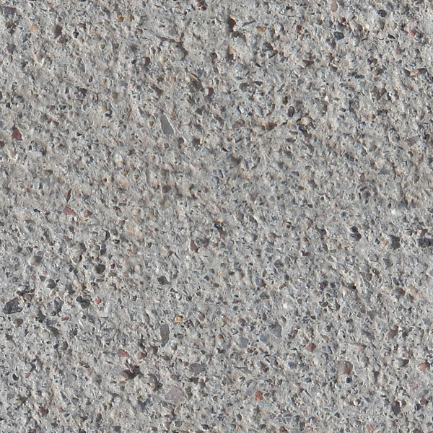
Materials

Slide 13
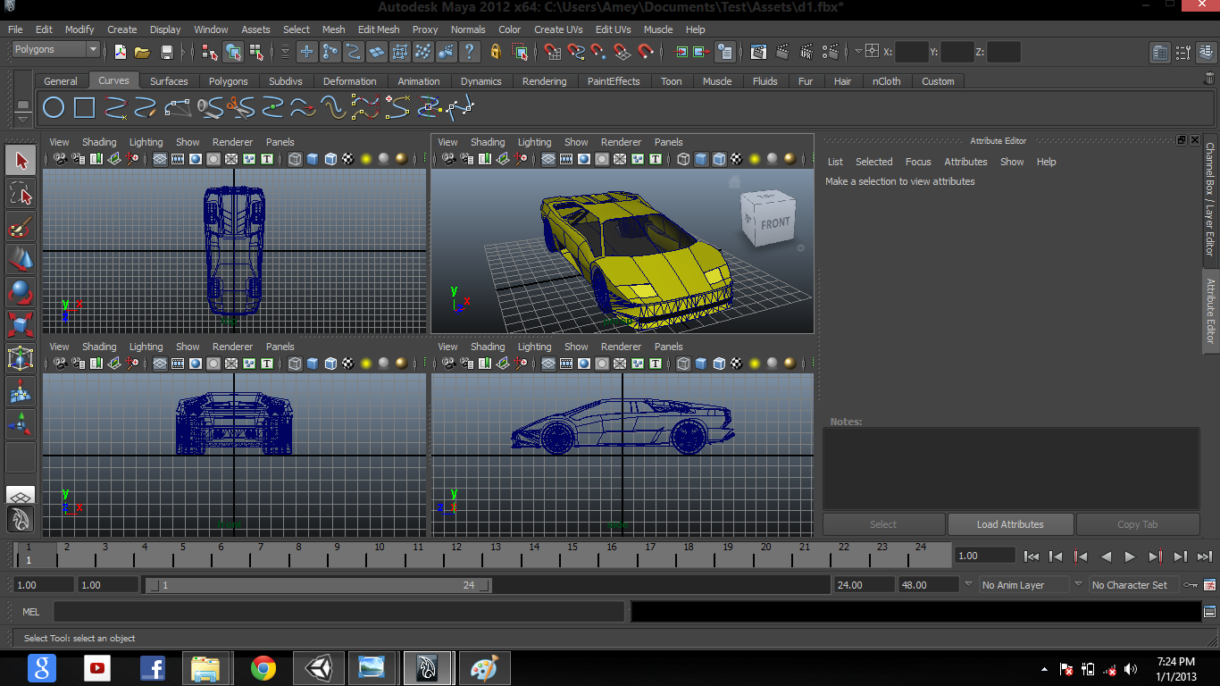

Slide 14
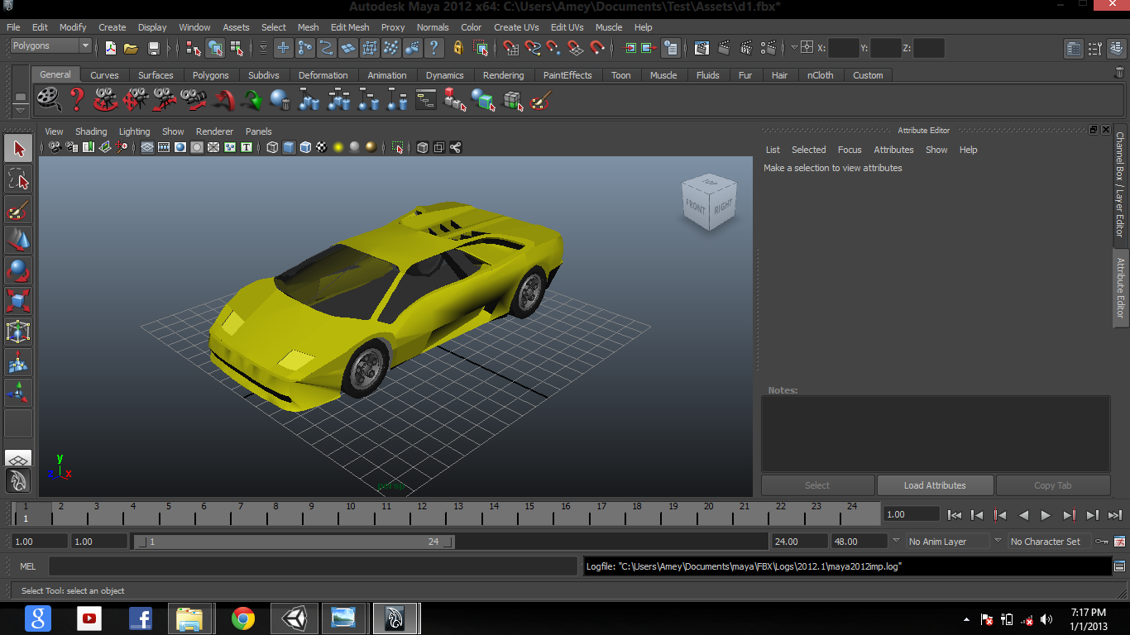
Final Model

Slide 15
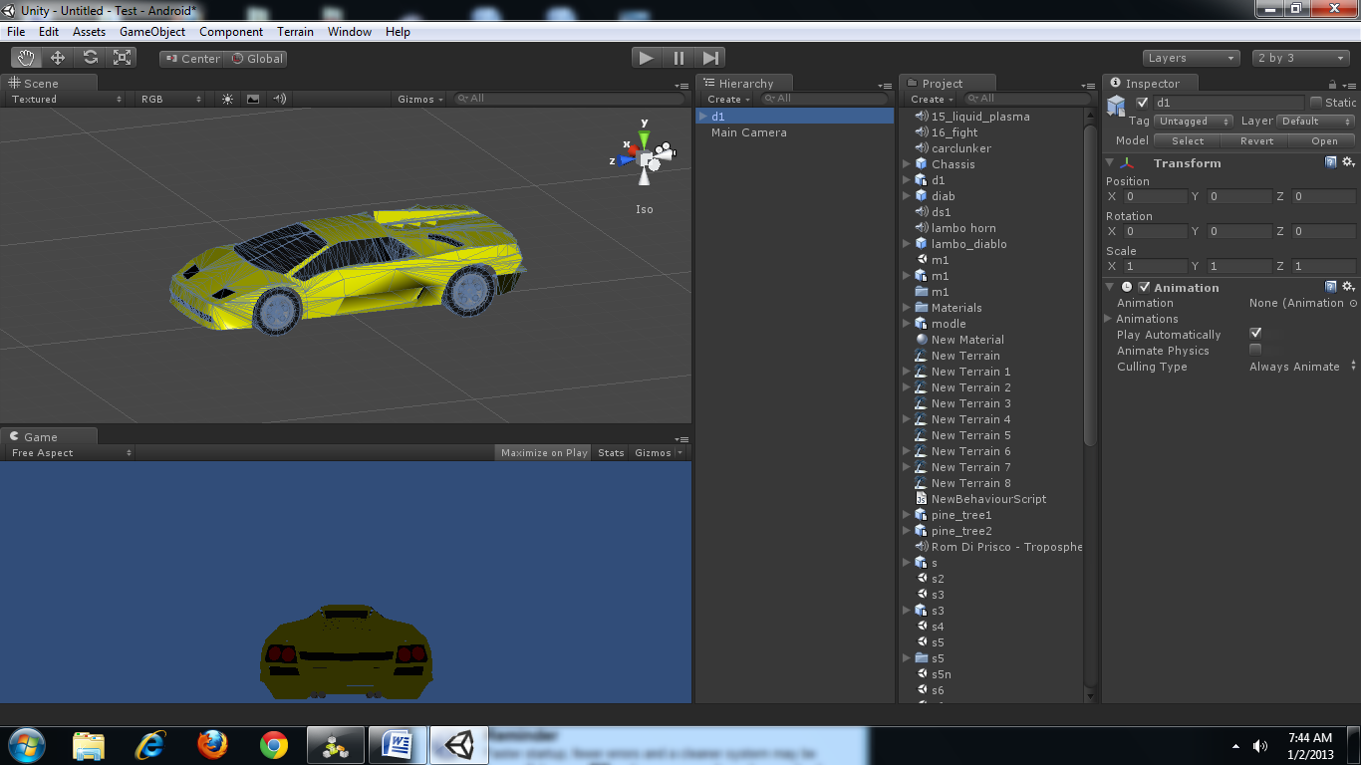
Export to Unity

Slide 16


The Environment
Track
Terrain
Skybox

Slide 17
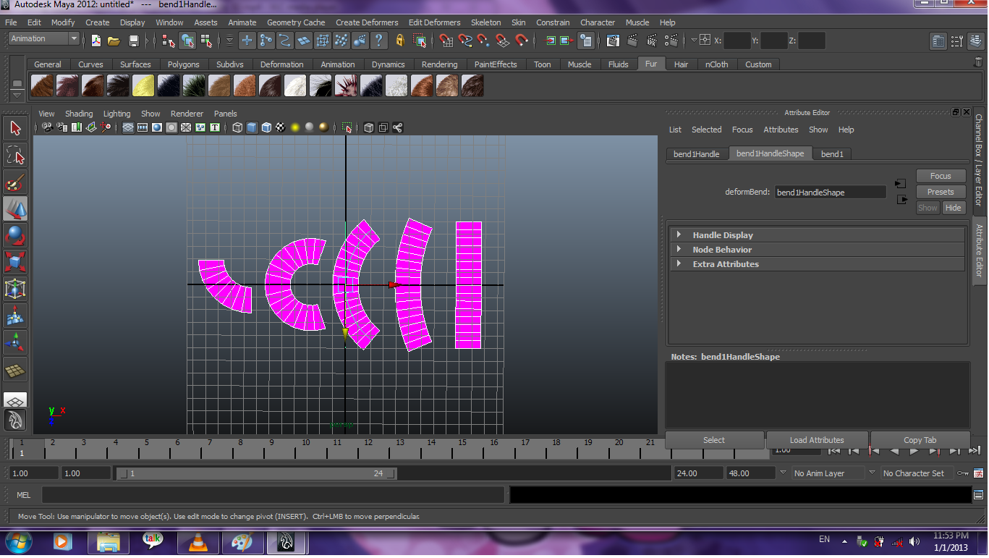
Bending Planes

Slide 18
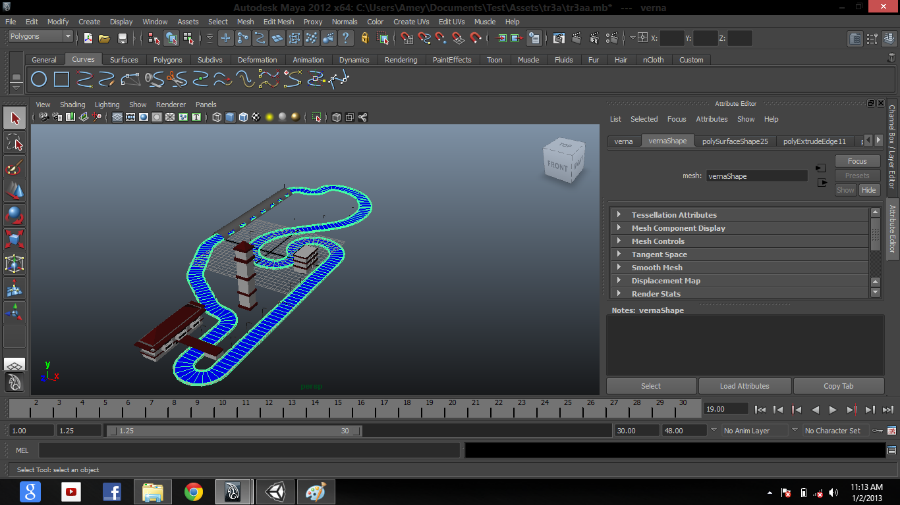
Artwork Track

Slide 19
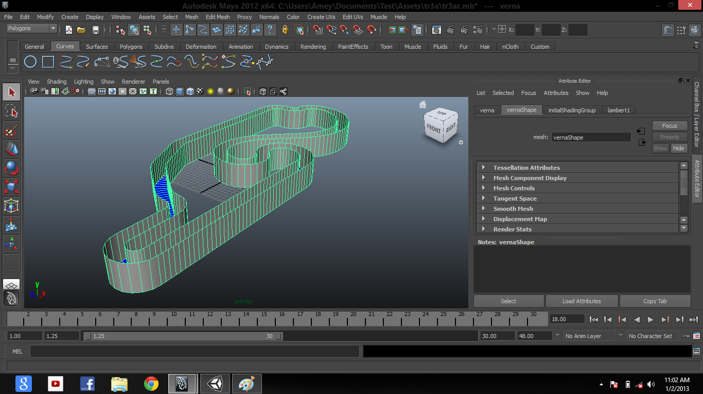
Collider Track

Slide 20
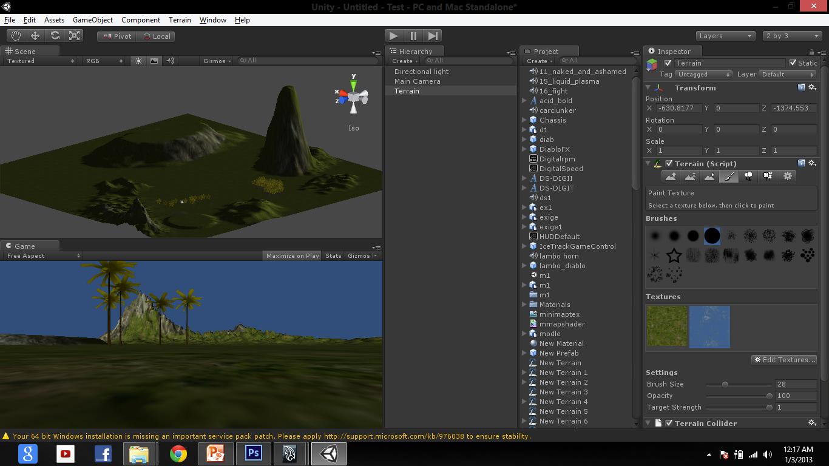
Terrain

Slide 21
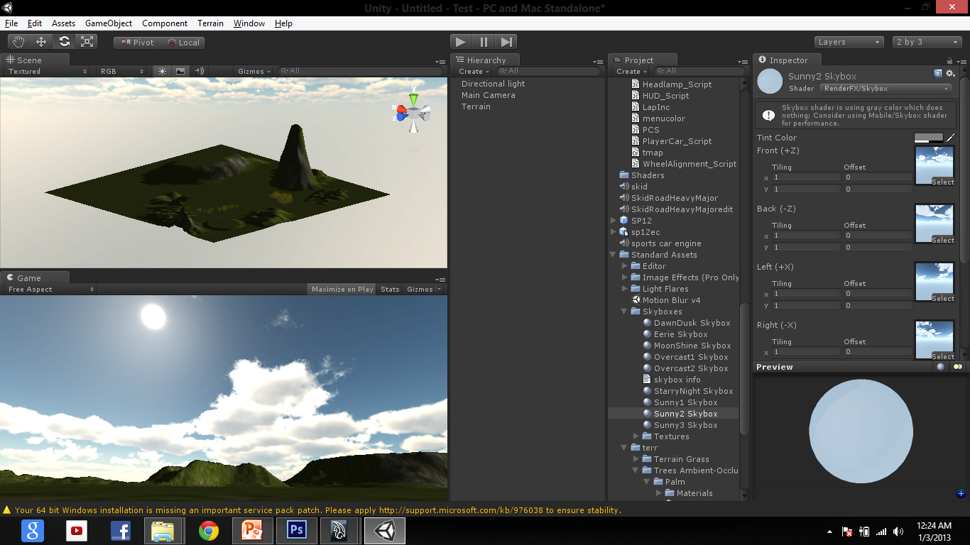
Skybox

Slide 22
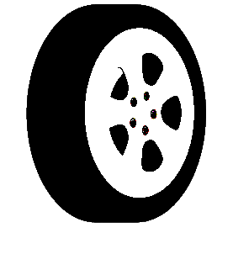

Car Rigging
Wheel Collider
Box Collider
Player Car
Script
Wheel Alignment
Script
Light
Script

Slide 23
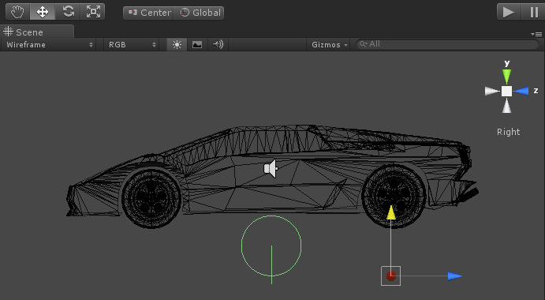
Wheel Colliders

Slide 24
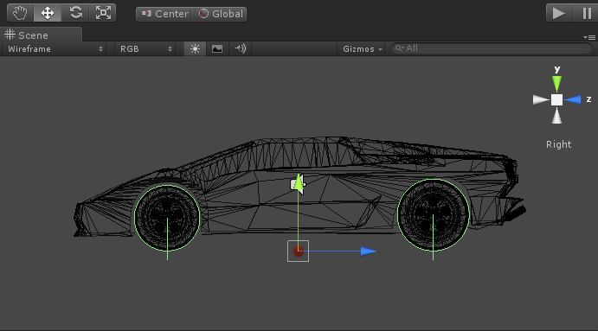

Slide 25
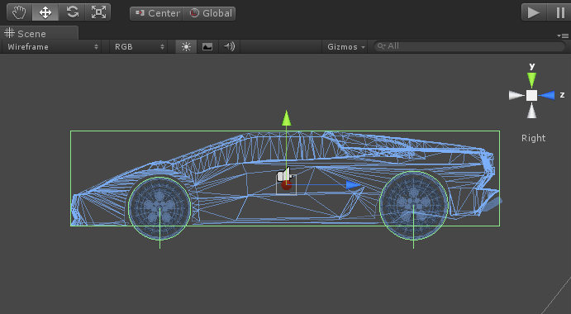
Box Collider

Slide 26
varFrontLeftWheel : WheelCollider;
varFrontRightWheel : WheelCollider;
varGearRatio : float[];
varCurrentGear : int = 0;
varEngineTorque : float = 230.0;
varMaxEngineRPM : float = 2000.0;
varMinEngineRPM : float = 1000.0;
privatevarEngineRPM : float = 0.0;
varrpmskin : GUISkin;
function Start ()
{
rigidbody.centerOfMass += Vector3(0, -1.4, .25);
}
Player Car
Script

Slide 27
function Update ()
{
EngineRPM = (FrontLeftWheel.rpm + FrontRightWheel.rpm)/2 * GearRatio[CurrentGear];
//GEAR SHIFT
//upshifting
if ( EngineRPM>= MaxEngineRPM )
{
var AppropriateGear : int = CurrentGear;
}
else if( FrontLeftWheel.motorTorque< -600)
{
CurrentGear = 3;
}
audio.pitch = Mathf.Abs(EngineRPM / MaxEngineRPM) + 1.0 ;
if ( audio.pitch> 2.0 )
{
audio.pitch = 2.0;
}

Slide 28
FrontLeftWheel.motorTorque = EngineTorque * GearRatio[CurrentGear]* Input.GetAxis("Vertical");
FrontRightWheel.motorTorque = EngineTorque * GearRatio[CurrentGear] * Input.GetAxis("Vertical");
FrontLeftWheel.steerAngle = (16 - rigidbody.velocity.magnitude*2.4*0.04545) * Input.GetAxis("Horizontal");
FrontRightWheel.steerAngle = (16 - rigidbody.velocity.magnitude*2.4*0.04545) * Input.GetAxis("Horizontal");
}
functionOnGUI ()
{
GUI.skin=rpmskin;
GUI.Label (Rect (Screen.width-80,350,200,150), (Mathf.Abs(Mathf.Floor(EngineRPM*3))).ToString());
if(EngineRPM>=0)
{
GUI.Label (Rect (Screen.width-80,380,200,150), (CurrentGear+1).ToString());
}
else
{
GUI.Label (Rect (Screen.width-80,380,200,150), "R");
}
}

Slide 29
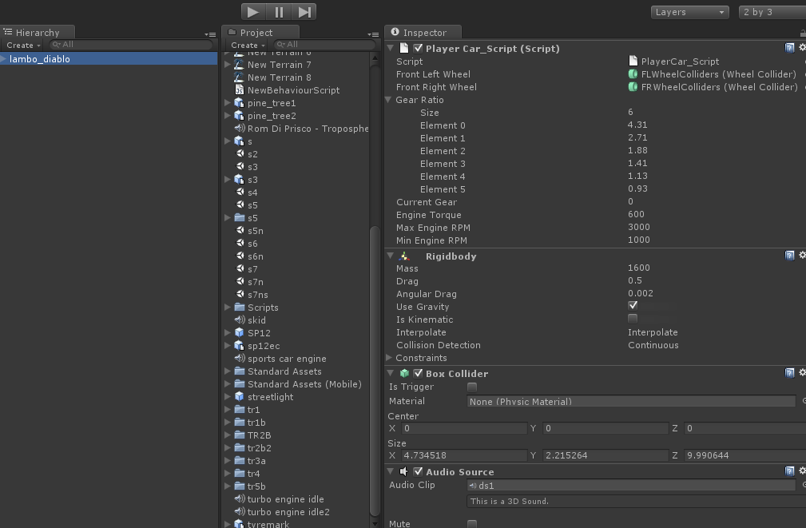

Slide 30
var CorrespondingCollider : WheelCollider; var SlipPrefab : GameObject; public var RotationValue : float = 0.0; var soundName : AudioClip;
function Update ()
{
var hit : RaycastHit; var ColliderCenterPoint : Vector3 = CorrespondingCollider.transform.TransformPoint(CorrespondingCollider.center); if ( Physics.Raycast( ColliderCenterPoint, -CorrespondingCollider.transform.up, hit, CorrespondingCollider.suspensionDistance + CorrespondingCollider.radius ) )
{
transform.position = hit.point + (CorrespondingCollider.transform.up * CorrespondingCollider.radius);
}
else
{
transform.position = ColliderCenterPoint - (CorrespondingCollider.transform.up * CorrespondingCollider.suspensionDistance);
}
Wheel Alignment
Script

Slide 31
transform.rotation = CorrespondingCollider.transform.rotation * Quaternion.Euler( RotationValue, CorrespondingCollider.steerAngle, 0); RotationValue += CorrespondingCollider.rpm * ( 360/60 ) * Time.deltaTime;
var CorrespondingGroundHit : WheelHit;
CorrespondingCollider.GetGroundHit( CorrespondingGroundHit );
if ( Mathf.Abs( CorrespondingGroundHit.sidewaysSlip ) > 11.5 )
{
if ( SlipPrefab )
{
Instantiate( SlipPrefab, CorrespondingGroundHit.point, Quaternion.identity ); audio.PlayOneShot(soundName);
}
} }

Slide 32
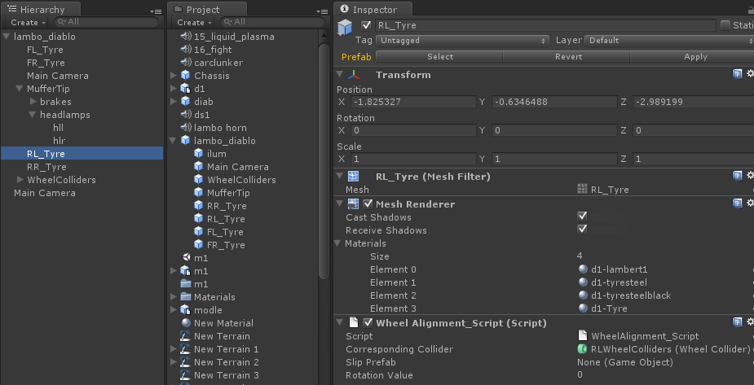

Slide 33
var hl1 : GameObject;
var rl : Light;
var hr1 : GameObject;
var ll: Light;
var f : uint;
function Start()
{
hl1.renderer.enabled = false;
hr1.renderer.enabled = false;
rl.enabled = !rl.enabled;
ll.enabled = !ll.enabled;
f = 0;
}
function Update ()
{
If(Input.GetKeyUp(KeyCode.L))
{
if(f==0)
{
hl1.renderer.enabled = true;
Light
Scripts
Headlamps

Slide 34
hr1.renderer.enabled = true;
f = 1;
}
else if(f==1)
{
hl1.renderer.enabled = false;
hr1.renderer.enabled = false;
f = 0;
}
rl.enabled = !rl.enabled;
ll.enabled = !ll.enabled;
}
}

Slide 35
var lbl : GameObject;
var rbl : GameObject;
function Start(){
lbl.renderer.enabled=false;
rbl.renderer.enabled=false;
}
function Update () {
If(Input.GetKeyDown(KeyCode.DownArrow))
{
lbl.renderer.enabled=true; rbl.renderer.enabled=true;
}
else if(Input.GetKeyUp(KeyCode.DownArrow))
{
lbl.renderer.enabled=false;
rbl.renderer.enabled=false;
}
}
Brakelamps

Slide 36


Tweaking
Lights
Particles
Minimap

Slide 37
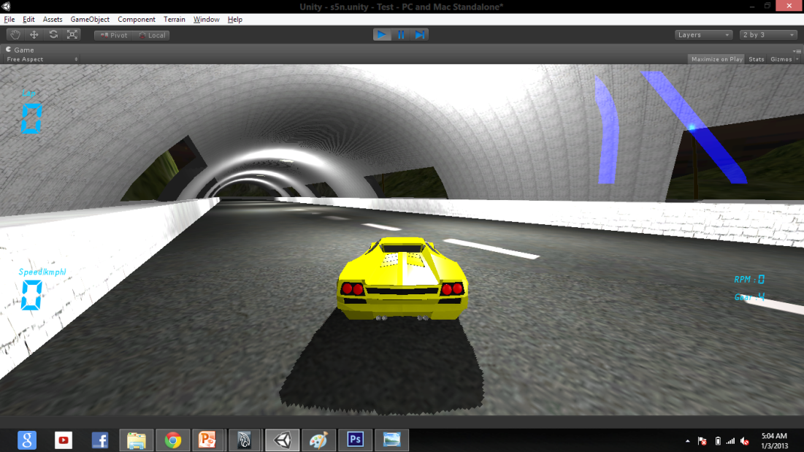
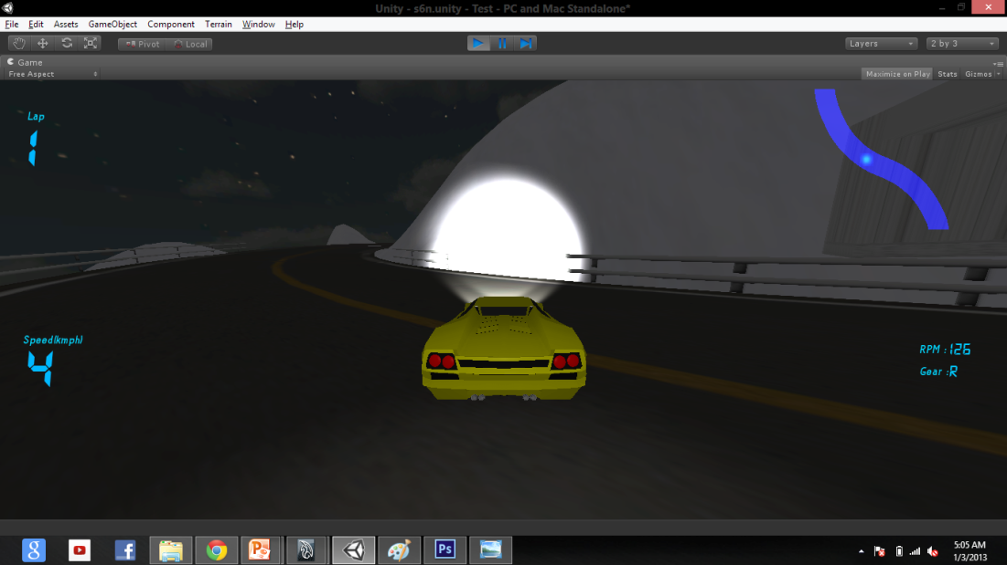
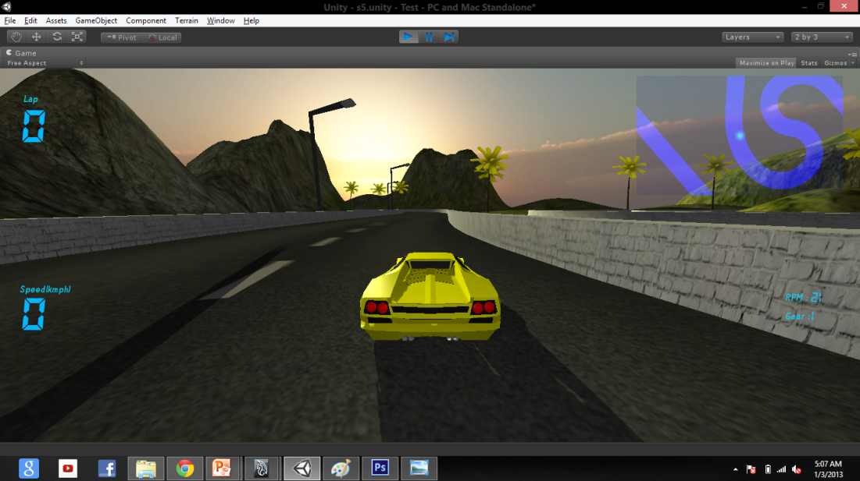
Pointlight
Lights
Spotlight
Directional light

Slide 38
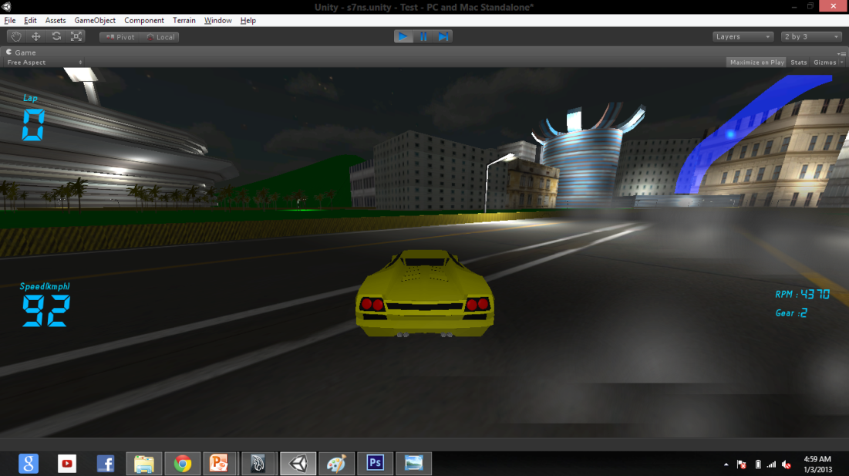
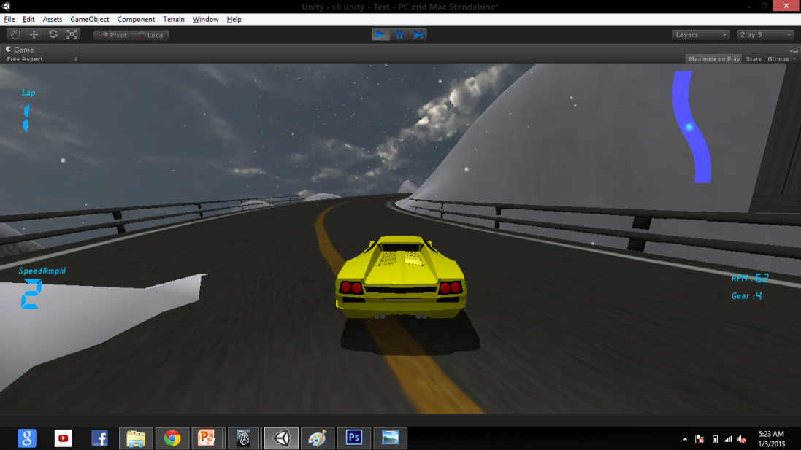
Particles

Slide 39
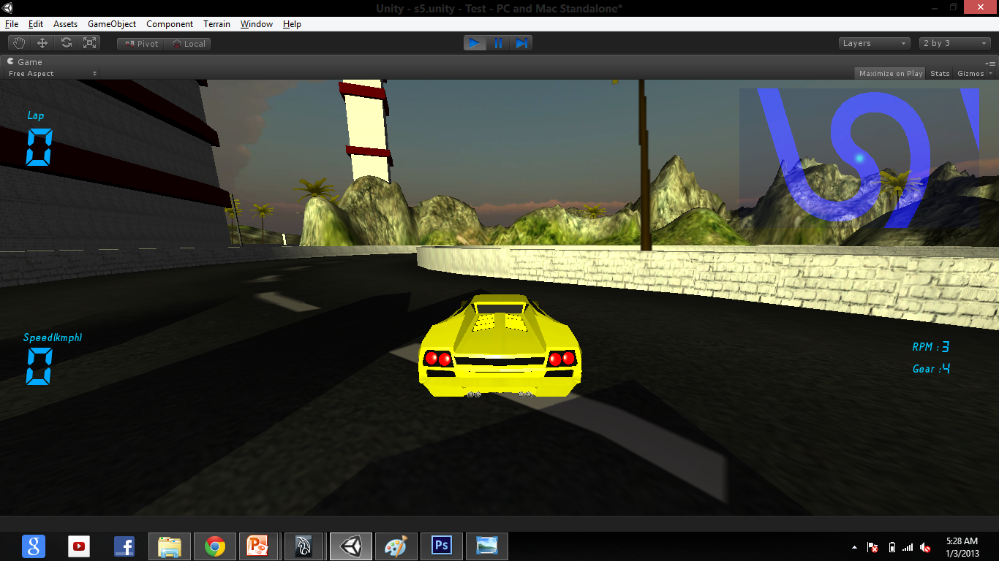
H.U.D.

Slide 40
☺
Thank you

